Slide 1
Team PCB
RISC-V Pipelined Processor
Prateek Tenkale, Chris Shannon, Brendan Callas

Slide 2
Checkpoints
Checkpoint 1
Base RISC-V Pipelined Processor
Checkpoint 2
L1 Cache
Hazard & Branch Prediction
Checkpoint 3
L2 Cache
Eviction Write Buffer
M-Extension
OBL Prefetcher
Checkpoint 4
BRAM
Improving Fmax
Optimizing Advanced Features

Slide 3
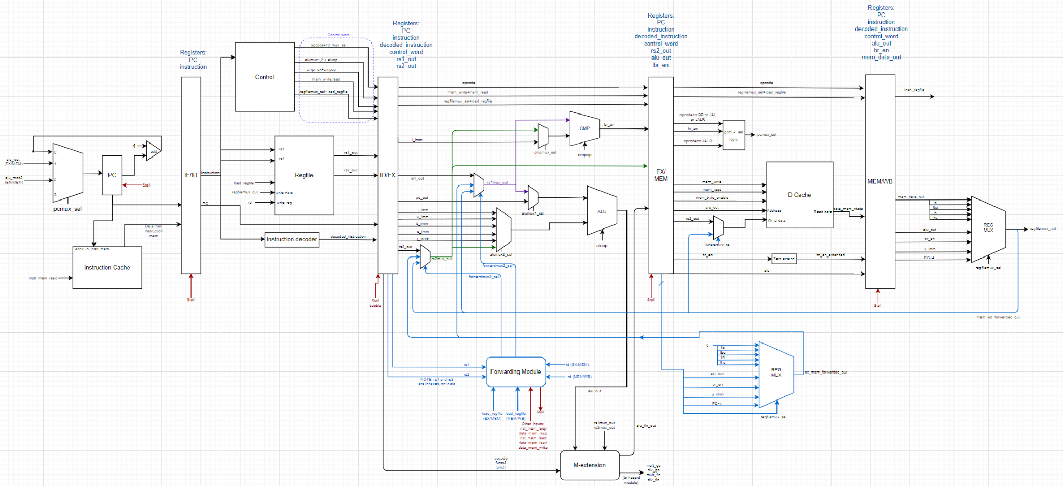
RISC-V 5-stage Pipeline Processor
Advanced Features:
L2 Cache, 8-way
Eviction Write Buffer
OBL Prefetcher
M-Extension

Slide 4
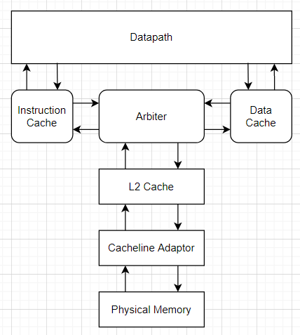
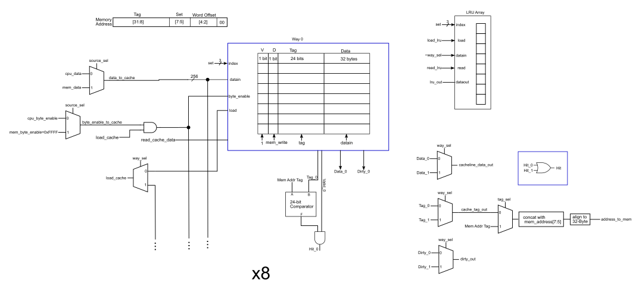
L2 Cache
Overview
8-way Set Associative
2-cycle
BRAM
Bit-pLRU
Performance Metrics
70% Hit Rate average
Comp2: 4772 hits, 1131 misses, 15 writebacks
Reduced comp1 and comp2 times by about 50%, comp1 time by 10%

Slide 5
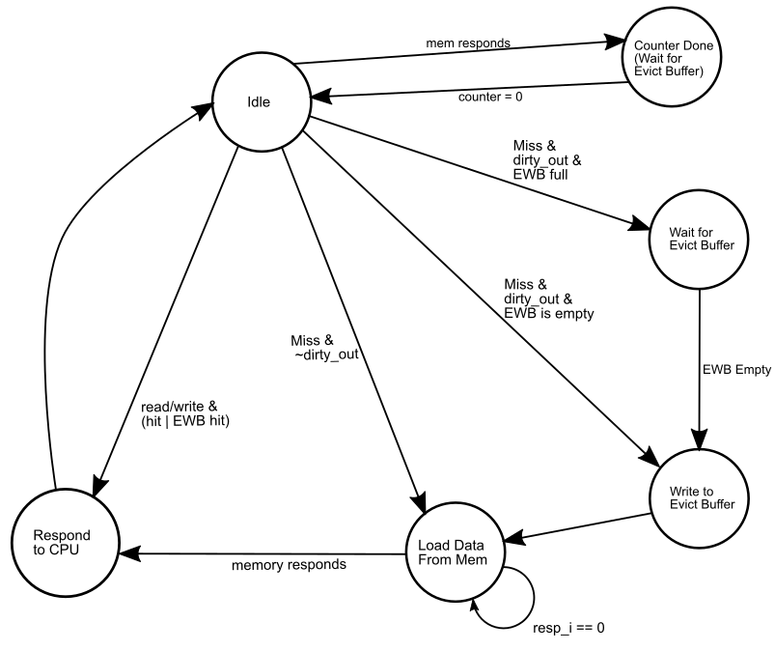
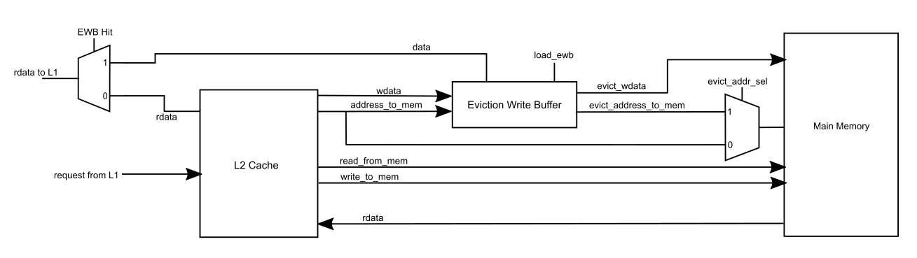
Eviction Write Buffer
Overview
Small buffer to hold evicted data
Allows L2 to write back and service misses much faster
Performance Metrics
655 writebacks total for competition code
31,385 cycles saved
24 hits
Underwhelming performance- relatively few writebacks

Slide 6
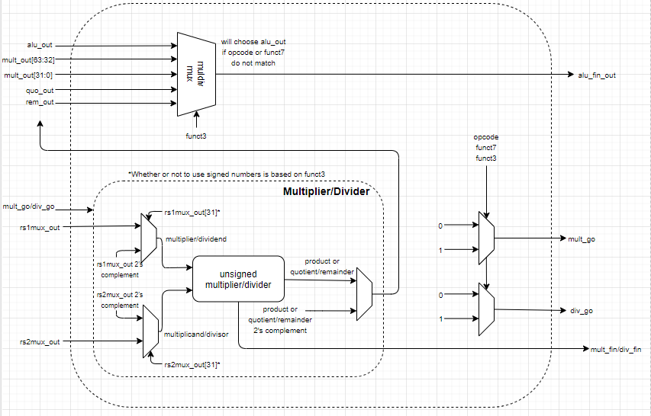
M-Extension
Overview
Multiplication uses add-shift algorithm
Division uses shift-subtract algorithm
Unit testing yielded all correct values, but we couldn’t get correct responses with comp2_m.s
Performance Metrics
Two variations of a factorial program, one using only adds and one using our new multiplication operation
On running these both on the test input 12!:
fact_add took 8085 ns
fact_mult took 6685 ns
17% speedup using mul

Slide 7
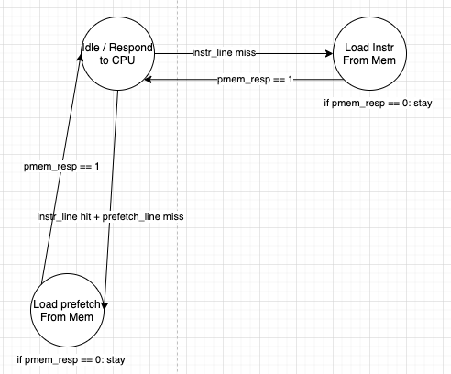
OBL Prefetcher
Overview
Implemented One Block Lookahead Prefetching on Instruction Cache (read-only)
First responds to original instruction (cache line i), then fetches the block ahead (i+1) from memory if it does not exist in cache
While waiting on i+1 block from physical memory:
Respond to Instruction Requests if it’s a Cache Hit
Doesn’t stall pipeline (unless there is also a data request)
 | % of hits | % of hits prefetched | Execution time % diff
comp1 | 99.64% | 83.59% | 139.14%
comp2_i | 98.39% | 72.61% | 112.08%
comp3 | 98.42% | 82.04% | 131.42%
Notes:
Arbiter was designed to prioritize instruction requests over data requests

Slide 8
Overall Performance
 | Comp Time | Comp Power | Score
comp1 | 656,146 ns | 884 mW | 2.497e-10
comp2_i | 2,363,225 ns | 867 mW | 1.144e-8
comp3 | 1,867,665 ns | 836 mW | 5.446e-9
FMax: 96 MHz
Total Score: 2.497e-9
Notes:
Without OBL Prefetching

Slide 9
What we wish we had done differently
EWB did not provide good performance increase
Difficulties with pipelined cache
Wallace Tree Multiplier, starting earlier on testing
Work to reduce power
OBL Prefetching: Modified Cache Arbiter to override prefetch requests with data requests

Slide 10
Questions?

